Slide 1
E – RESQ I N D O N E S I A
Robocup Asia Pacific 2022
CoSpace Rescue Challenge U-19

Slide 2
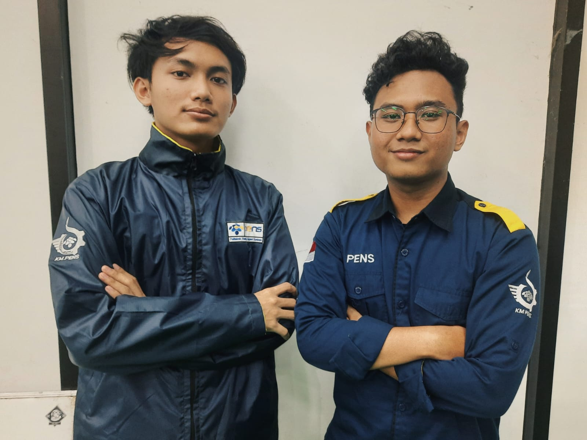
E – RESQ
Septian Bagus Jumantoro
Rohman Aditiya
Programmer
Team Leader &
Strategist
Finalist RCAP 2022 CoSpace Rescue U-19
Contributed to EEPIS Flying Robot Research
Student of Politeknik Elektronika Negeri Surabaya
Finalist RCAP 2022 CoSpace Rescue U-19
Contributed to EEPIS Flying Robot Research
Student of Politeknik Elektronika Negeri Surabaya

Slide 3
Executive Summary of Preliminary Challenge
Category: RCAP CoSpace Rescue Challenge U19
Overview: In this challenge we program our robot to gather objects (cyan, red, black) and deposit to orange area whenever the robot has 6 loaded objects. There is also some obstacles and traps that robot have to avoid. Multiple strategies are used so that the robot can score points as much as possible under 6 minutes.

Slide 4
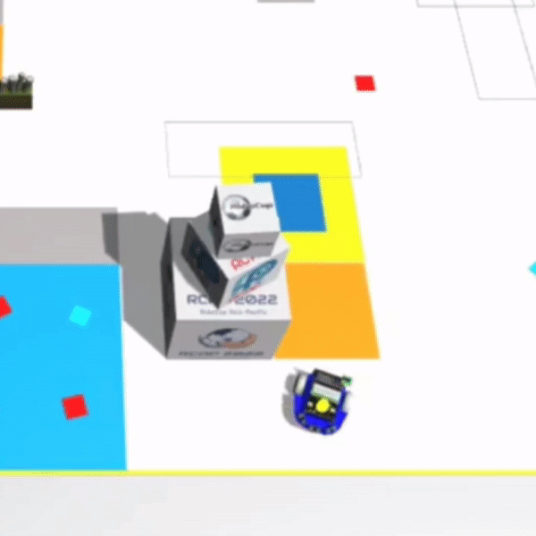
Strategy 1: Obstacle Avoidance
Method: Using the ultrasonic sensor to detect obstacles and control the wheel to avoid obstacle

Slide 5
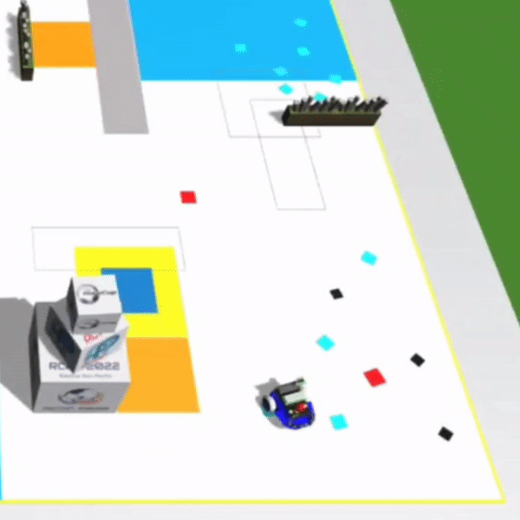
Strategy 2: Boundaries Avoidance
Method: Using the compass and position sensor to avoid boundaries

Slide 6
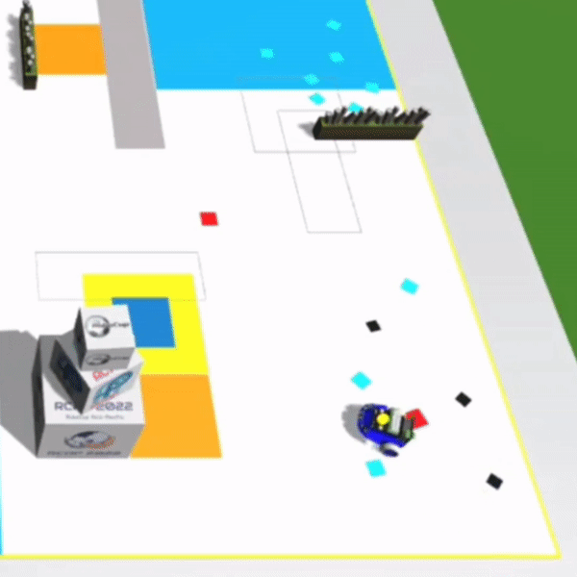
Strategy 3: Trap Avoidance
Method: Using the color sensor to detect yellow area to avoid traps

Slide 7
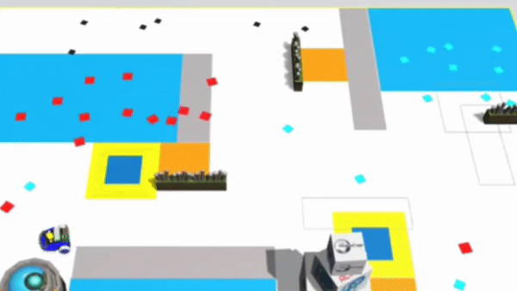
Strategy 4: Zone Mapping
Method: Using the position sensor to read the map and navigate to the waypoint. This strategy is used to increase chance of gather objects and getting the super gem faster.

Slide 8
Executive Summary of Preliminary Challenge
Result: The robot completed mission with smoothly and efficiently, and gained 2460 points in the preliminary challenge.
Conclusion:
Completed mission using obstacle and multiple algorithm avoidance to avoid the obstacles
Robot successfully gathered and deposit objects by using multiple algorithm and strategies

Slide 9
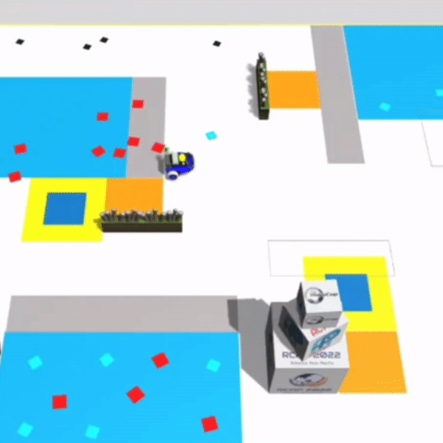
How To Navigate Robot Waypoint with Zone Mapping

Slide 10
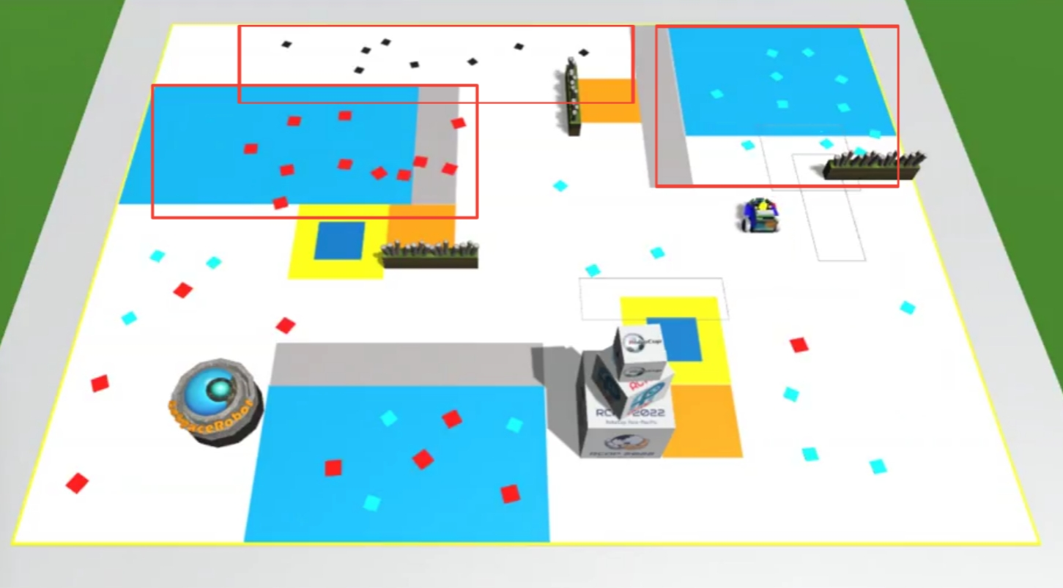
Step 1: Find a Unique Area
Unique area is an area that contains many objects with the same color. So in order to get super gem faster we need to find many cyan/red/black objects gathered in some area.

Slide 11
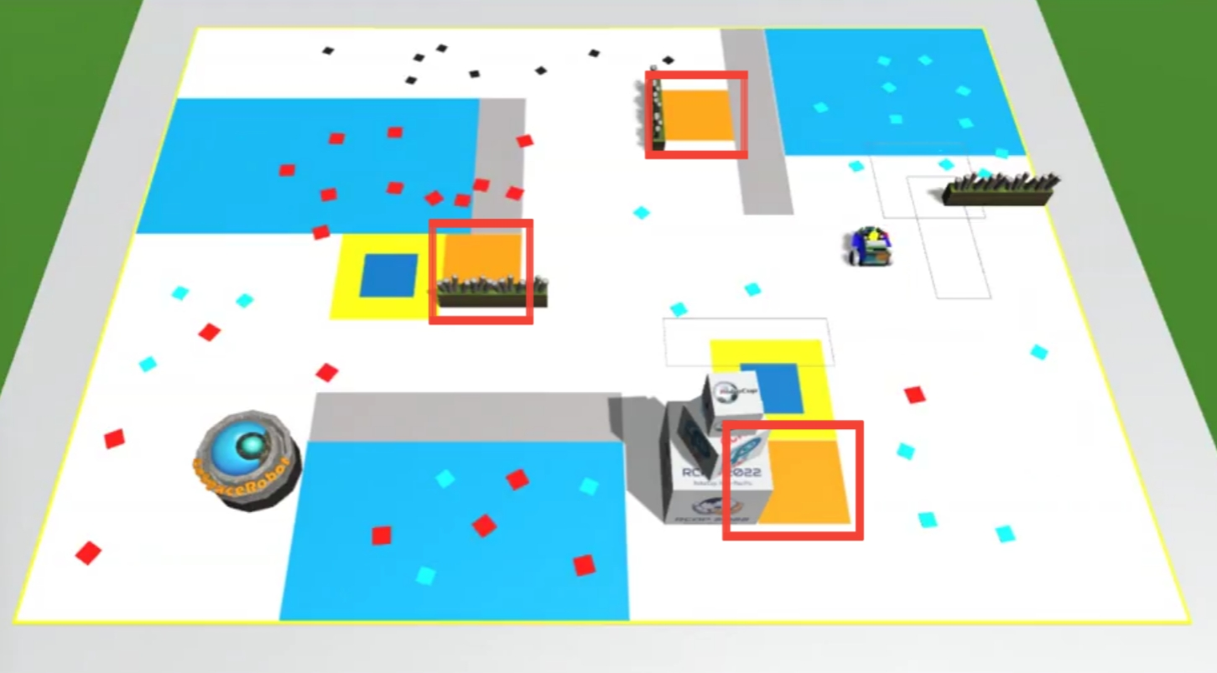
Step 2: Get coordinates of Deposit Zone
After we find a unique area, we need to get the coordinates of deposit zone so that the robot can deposit the objects whenever robot has 6 loaded objects.

Slide 12
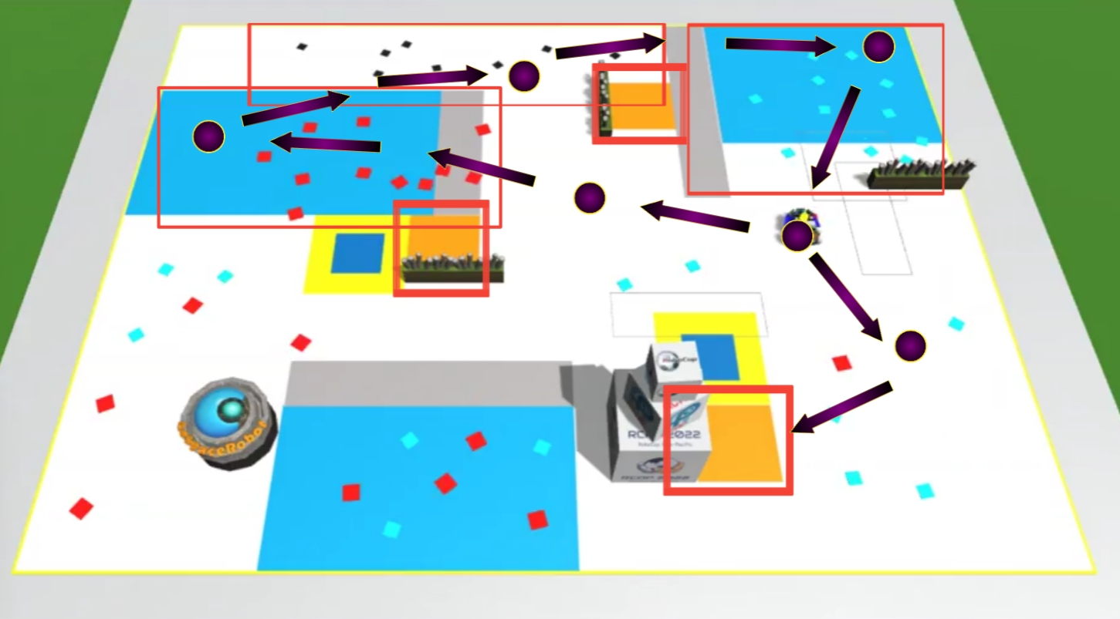
Step 3: Add Waypoint
Waypoint is used to create navigation for the robot to move on to desired place or zone. This helps the robot to avoid area that contains many obstacles or traps.

Slide 13
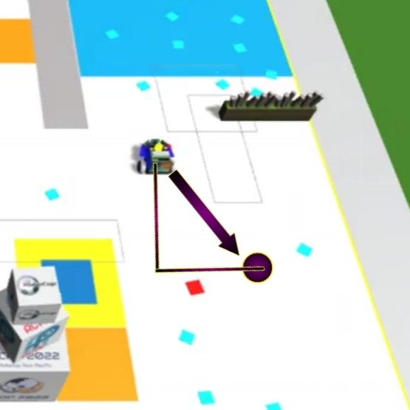
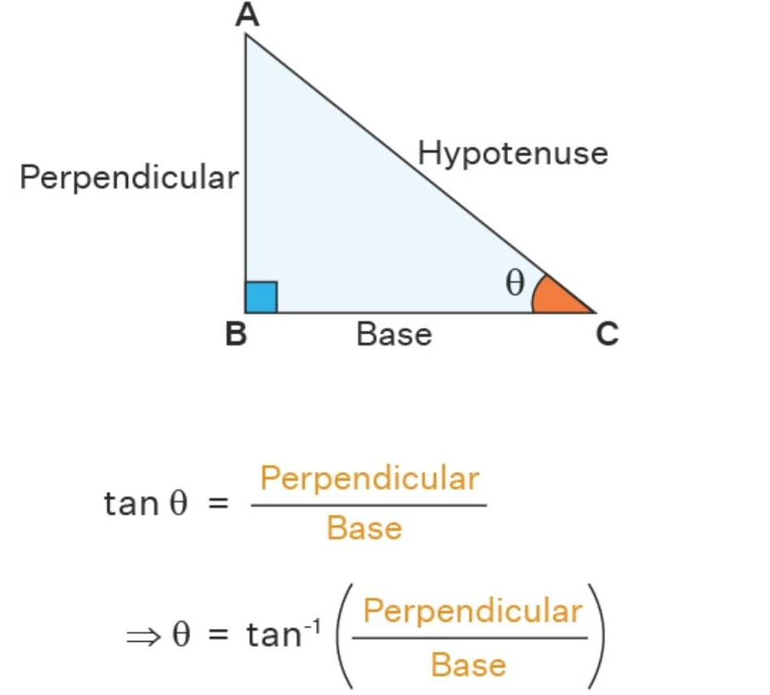
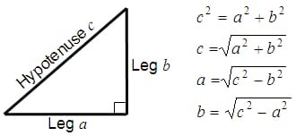
Step 4: Dead Reckoning Navigation
This is a process to calculate track estimation from determined position and waypoint. This step is used by the robot to move on to the desired waypoint. Dead Reckoning used trigonometry formula where we need to find Hypotenuse from delta position of the robot. Then, we can get the degree from arctan of X/Y as the value of robot drift.

Slide 14
The Game

Slide 15
Applying Knowledge Gained to The Real World
In our life, we can apply Zone Mapping Strategy for Drones to Observe the activity of the Volcano Mountain

